Slide 1


Blockchain Hackathon BUSINESS TRACK : Block-busters Smart Real-time on-road contracts

Slide 2






Block-Busters: Team members
Blockchain Hackathon - Business Track | Presentation
Team member Name | Shashank Mallikarjun | Rahul Thippeswamy Girijal | Deepak Nadagouda | Sumathi Kulkarni
Department | RBEI/ESP | RBEI/ESP | RBEI/ESP | RBEI/ESP
Role | Senior Software Engineer | Senior Software Engineer | Senior Software Engineer | Senior Software Engineer
Linkedin | https://www.linkedin.com/in/shashank-m-57488a37/ | https://www.linkedin.com/in/rahul-tg-2a593015b/ | https://www.linkedin.com/in/deepak-n-961bb086/ | https://www.linkedin.com/in/sumathi-kulkarni-68b01765/
Interesting fact | I like geography | I like cooking | I like to travel, meet & explore | I am a foodie
Why do you want to participate in hackathon? | To explore new business cases for blockchain & learn more | To learn more about blockchain technology & gain experience in the field | To explore the various possibilities of tackling current issues with Block Chain | To learn more about different areas in blockchain and have fun along the way
Email address | Shashank.Mallikarjun@in.bosch.com | Rahul.ThippeswamyGirijal@in.bosch.com | Nadagouda.Deepak@in.bosch.com | Sumathi.Kulkarni2@in.bosch.com
2
Internal | RBEI-BE-II | 2019-01-16
© Robert Bosch Engineering and Business Solutions Private Limited 2019. All rights reserved, also regarding any disposal, exploitation, reproduction, editing, distribution, as well as in the event of applications for industrial property rights.

Slide 3


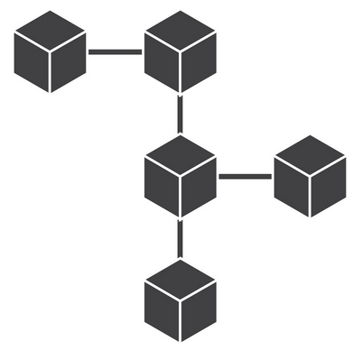
Blockchain Hackathon - Business Track | Presentation
Executive Summary
Smart contracts to positively influence vehicle driving behavior
using real-time on-road agreements via block-chain
$
4. Payment complete
after successful overtaking *
In order to better understand our proposal, let us have a look at some scenarios. Scenario 1 (see adjacent figure): A driver is in a hurry and is willing to pay a small amount to the vehicles in front of him so that they allow him to overtake them (in return for the
incentive). Scenario 2: An Ambulance or emergency vehicle is making its way to its destination. The
Vehicles around it are more likely to make way if they get an incentive for positive behavior. (Ex: coupons for medical purchase) Scenario 3: Traffic police want to re-route a portion of the vehicles to prevent traffic from
getting worse. The re-routed vehicles are more likely to voluntarily take a different route in
return for an incentive. This scenario can also be further extended to make certain roads
cheaper (or expensive) to ease traffic flow and prevent congestion, paving the way for
dynamic pricing of roads.
To enable the above mentioned scenarios, we propose a decentralized real-time on-road
smart contract system. This system would handle these transactions seamlessly. In addition,
such a system would form the basis for an automatic on-road smart contract system for
autonomous vehicles in the future.
2. Overtake request
Broadcasted to all vehicles
3. Overtake request
accepted
1. Request to overtake
& move faster (price included)
* Wait for a pre-defined time and then complete payment

Slide 4
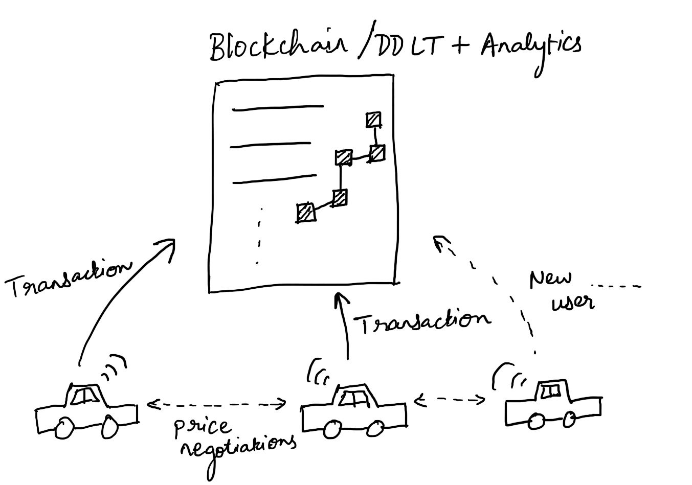
Blockchain Hackathon - Business Track | Presentation
Executive Summary

Slide 5
Initial Hypothesis/Assumptions
Smart Real-Time On-Road Contracts
Primary research – Quantitative & Qualitative
People are willing to pay to go fast
People are willing to accept incentives to change behavior
We can route traffic based on an incentive system
We can control road prices dynamically through this system
We can create a decentralized system to perform all these activities
Secondary research – Existing projects around the world
Secondary research about technical feasibility
5
Internal | RBEI/EMB - Prash | RBEI/ETS - Manoj | 2019-01-16
© Robert Bosch Engineering and Business Solutions Private Limited 2019. All rights reserved, also regarding any disposal, exploitation, reproduction, editing, distribution, as well as in the event of applications for industrial property rights.

Slide 6
Primary research – Quantitative & Qualitative
Smart Real-Time On-Road Contracts
Online survey: https://bit.ly/2W1Lk5B
Summary:
81 participants
Age group 18-29: 79%
Preferred mode of transport:
2 wheeler: 47%
4 wheeler: 28%
~60% spend more than 1 hour on road everyday
79% think they can reduce their on-road time
60% are willing to pay to go faster
54% are willing to accept payments/incentives to allow others to overtake them
6
Internal | RBEI/EMB - Prash | RBEI/ETS - Manoj | 2019-01-16
© Robert Bosch Engineering and Business Solutions Private Limited 2019. All rights reserved, also regarding any disposal, exploitation, reproduction, editing, distribution, as well as in the event of applications for industrial property rights.

Slide 7
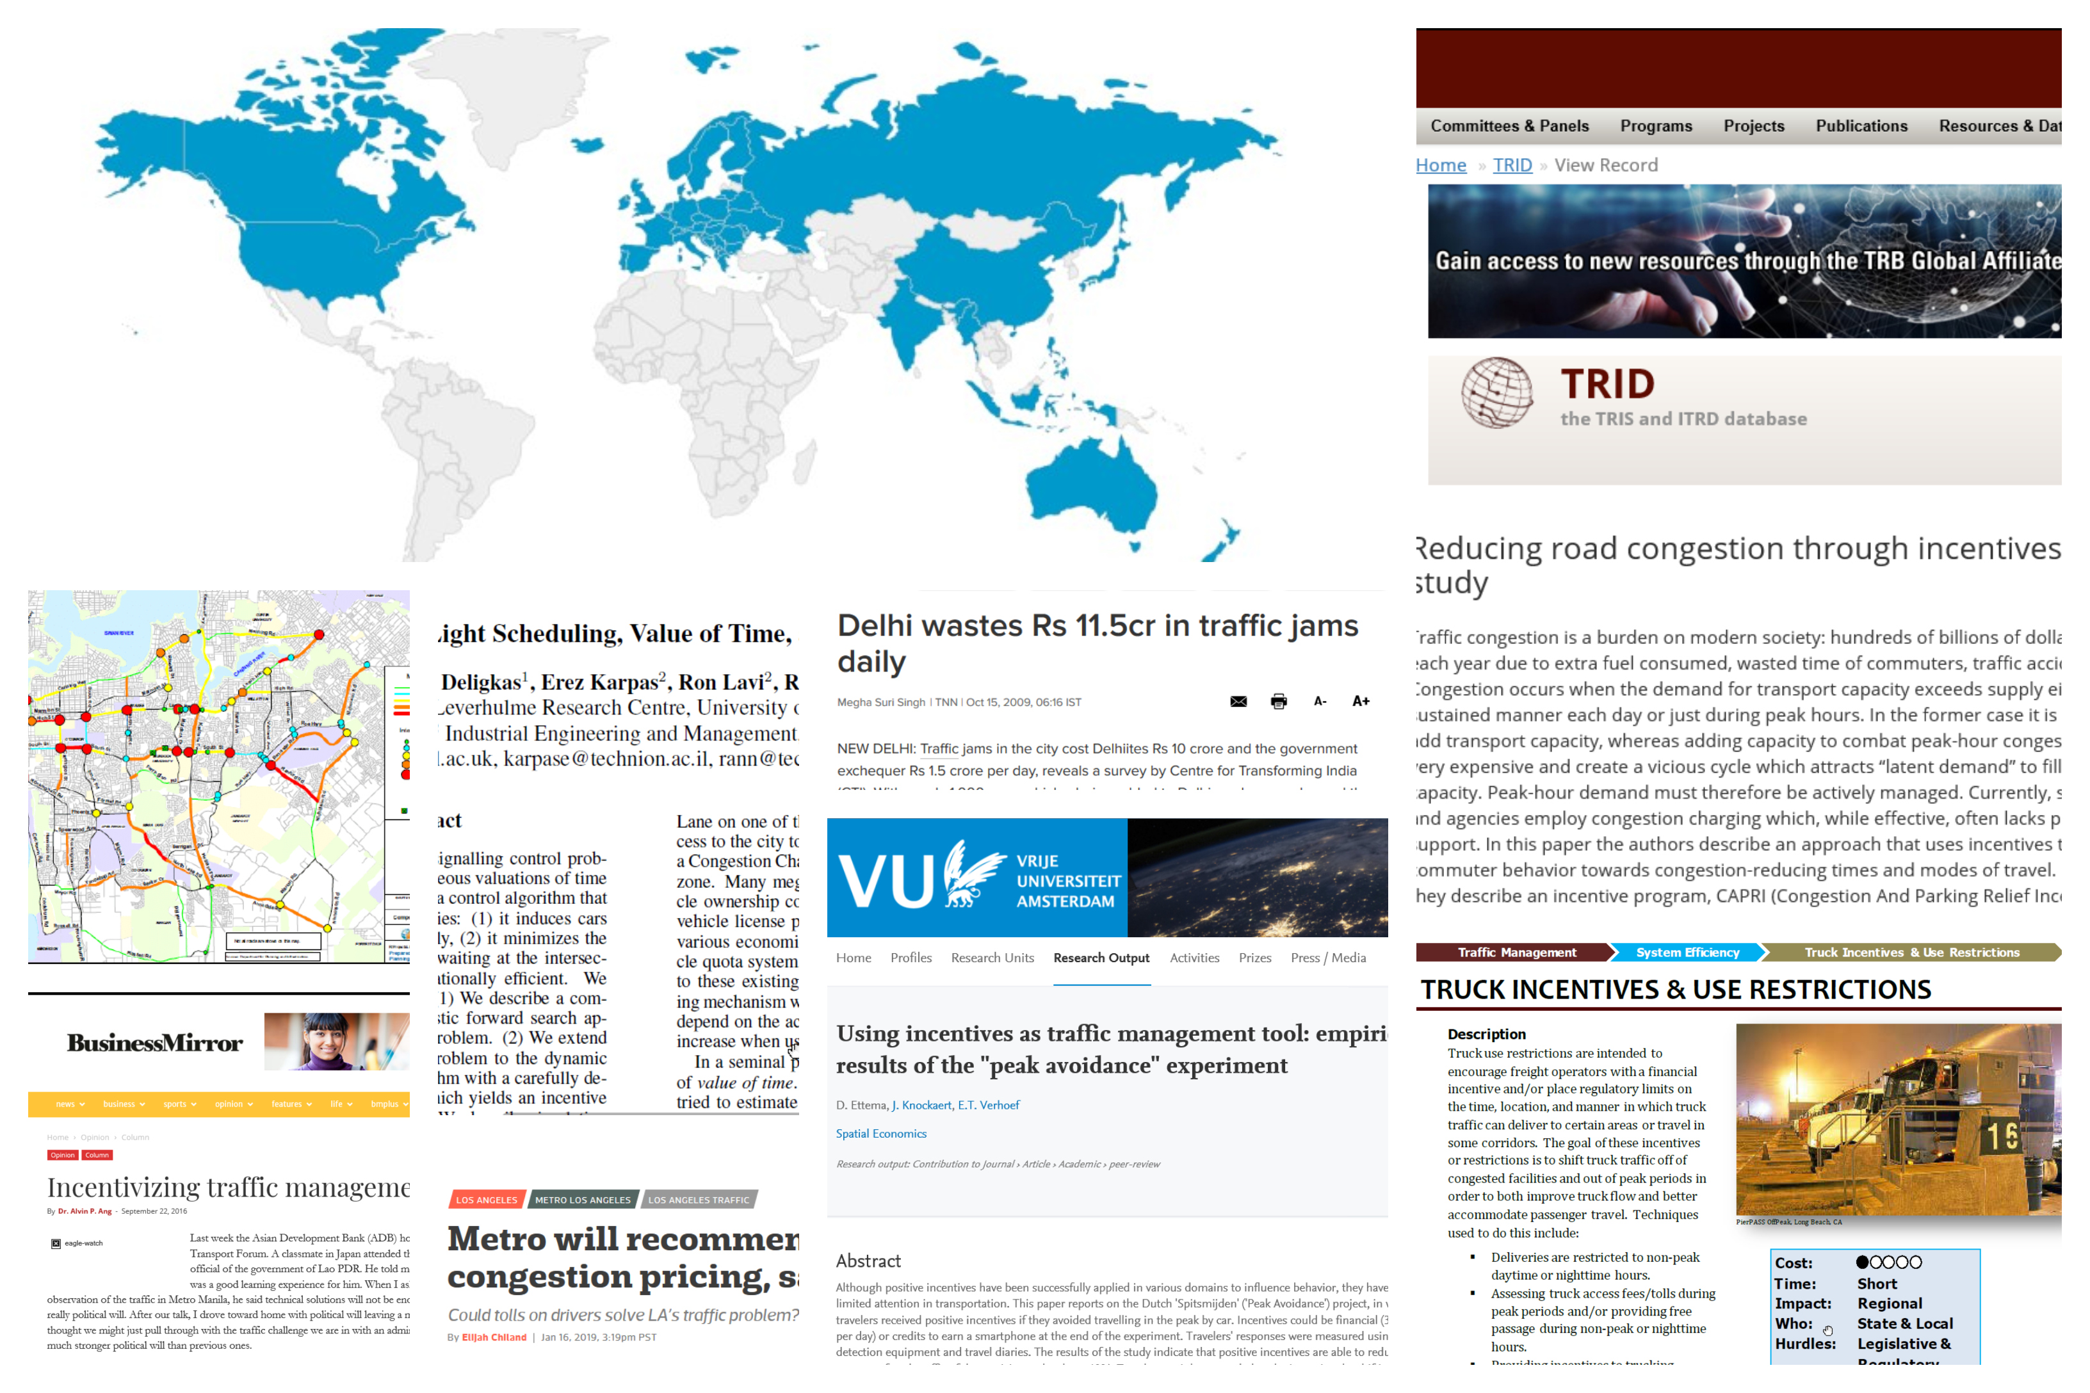
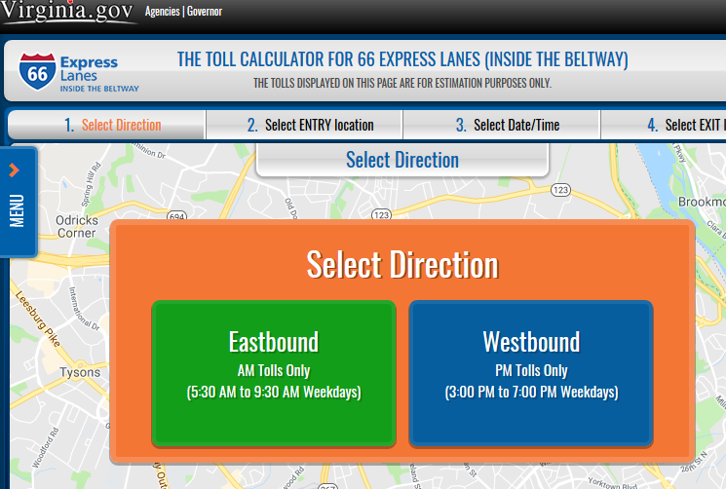
Secondary research – Existing projects around the world
Smart Real-Time On-Road Contracts
7
Internal | RBEI/EMB - Prash | RBEI/ETS - Manoj | 2019-01-16
© Robert Bosch Engineering and Business Solutions Private Limited 2019. All rights reserved, also regarding any disposal, exploitation, reproduction, editing, distribution, as well as in the event of applications for industrial property rights.

Slide 8



Smart real-time on-road contracts
Team Name: Block-Busters
Blockchain Hackathon - Business Track
Key partners
Key Activities
Value Proposition
Customer Relationships
Customer Segments
Data analysis & improvement
Automatic bidding, broadcasting messages
Collaboration of partners into the common platform
Vehicle to vehicle communication
Providing a platform for incentive exchange
Analytics and routing tool
Assistance in providing rapid response
Vehicle drivers:
- Taxi/Auto
- Personal cars
- Truck drivers
etc.
Government regulatory bodies
- Traffic management
- Pollution control
board
Emergency services:
- Ambulance
- Fire engine
- Police patrol
Smart real-time on-road contracts
Convenient overtaking & speeding
Assisted route clearance
Incentives for lane discipline
Dynamic pricing
Traffic routing and management tools
Incentive providers (Ex: PayTM, Paypal)
Blockchain miners
Traffic forecasting entities
Government regulatory bodies
Investors/Venture capitalists
Key Resources
Channels
Algorithms, data analytics capability
Platform architecture
User generated information
Branding & application
Smart-phone app
Integration within in-car infotainment system
Integration within self-driving vehicle software
Cost Structure
Revenue stream
Payment for services utilized (map & traffic data)
Development & expansion
Infrastructure & transaction cost
Customer support
Transaction fee for every payment
Subscription based model (weekly, monthly)
Partnership with incentive providers
Mining rewards
8
Internal | RBEI/EMB - Prash | RBEI/ETS - Manoj | 2019-01-16
© Robert Bosch Engineering and Business Solutions Private Limited 2019. All rights reserved, also regarding any disposal, exploitation, reproduction, editing, distribution, as well as in the event of applications for industrial property rights.

Slide 9
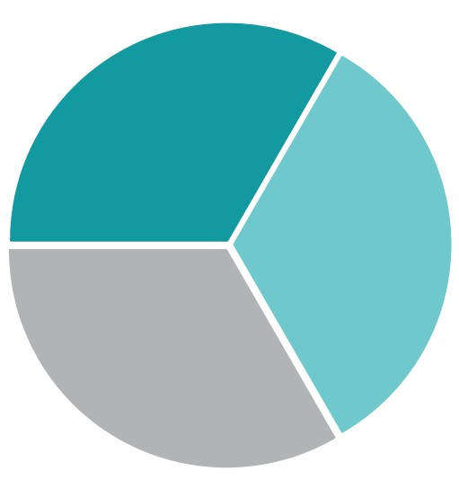

VPC
Blockchain Hackathon - Business Track
Gains ☺
Monetary benefits
Reduced travel time
Better traffic management
Lane discipline
Dynamic pricing of roads without new infrastructure
- Reduced reaction time
Improved vehicle performance
Gain Creators
Automatic payment gateway
Paid overtaking options
Dynamic pricing mechanism
Convenient speeding and overtaking
Vehicle drivers:
Products/
Services
Smart real-time
on-road contracts
Dynamic pricing
Automatic bidding
Customer Jobs
Stuck in traffic
Higher commuting time
Difficulty in managing
traffic
Postponed
emergency services
Pains ☹
Frustration due to traffic
Losing valuable time
Undisciplined driving
Lack of traffic routing tools
Emergency response delayed
Pollution (noise/air)
Reduction in vehicle efficiency
Traffic Management
Pain Relievers
Saving time through on-road contracts
Incentives for lane discipline
Online traffic routing
Assisted route clearance
Emergency services
9
Internal | RBEI/EMB - Prash | RBEI/ETS - Manoj | 2019-01-16
© Robert Bosch Engineering and Business Solutions Private Limited 2019. All rights reserved, also regarding any disposal, exploitation, reproduction, editing, distribution, as well as in the event of applications for industrial property rights.

Slide 10
BMC Enablers and Enhancers
Blockchain Hackathon - Business Track | Presentation
Leverage of Technology
No central approving authority
Immutable history of all transactions
Payment gateway included
Anyone can join the network (decentralized)
Bosch Relevant
Experience in maintaining a public block-chain platform & gaining expertise in the domain
Creating a marketplace ready for autonomous vehicle smart contracts in the future, and supplying related parts
Penetrating new markets such as traffic management, digital payments
Increased brand value as a result of solving pressing public issues in the automotive field
10
Internal | RBEI/EMB - Prash | RBEI/ETS - Manoj | 2019-01-16
© Robert Bosch Engineering and Business Solutions Private Limited 2019. All rights reserved, also regarding any disposal, exploitation, reproduction, editing, distribution, as well as in the event of applications for industrial property rights.

Slide 11
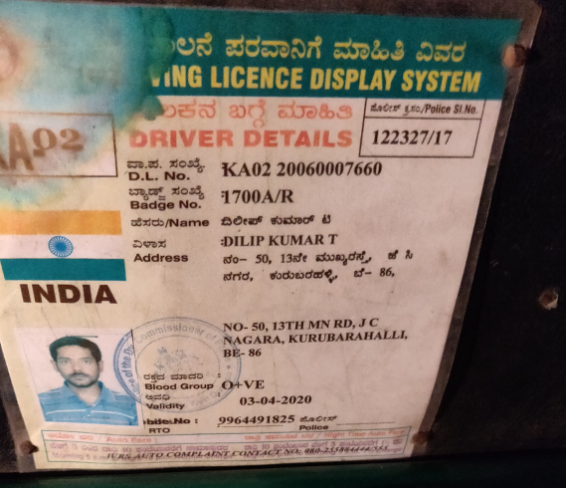
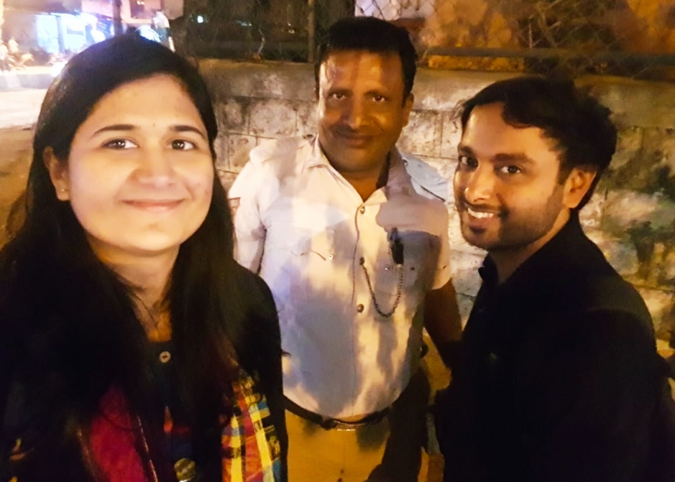
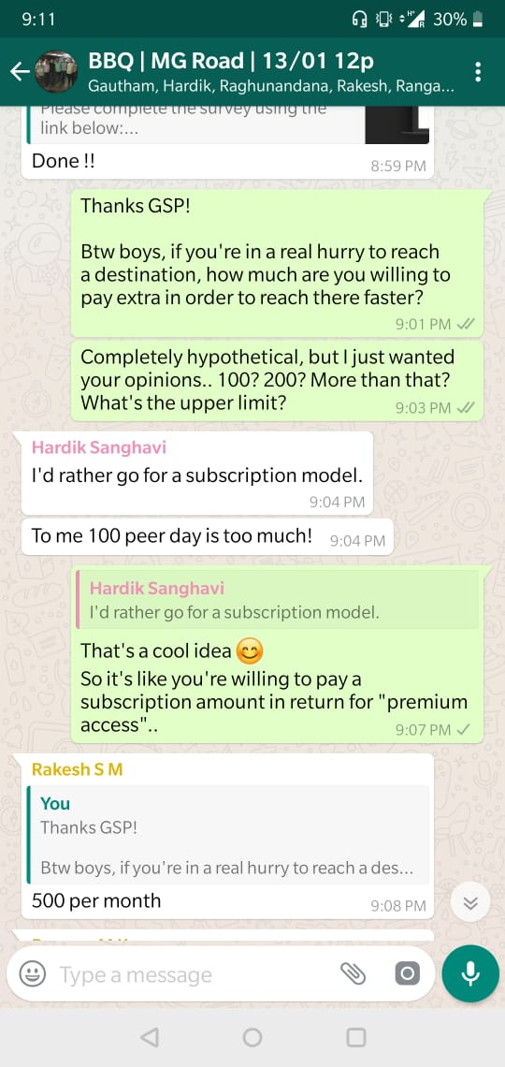
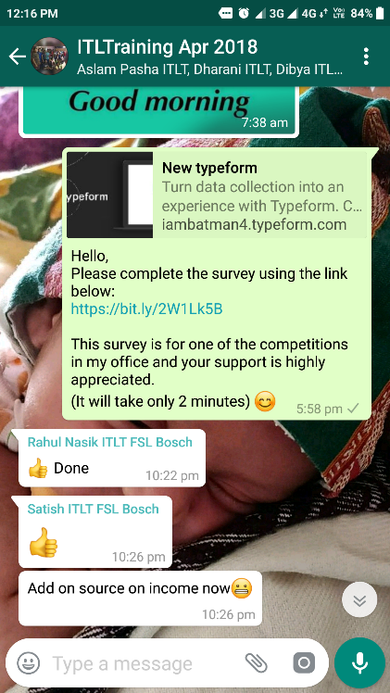
Talking to real people!
Blockchain Hackathon - Business Track | Presentation
11
Internal | RBEI/EMB - Prash | RBEI/ETS - Manoj | 2019-01-16
© Robert Bosch Engineering and Business Solutions Private Limited 2019. All rights reserved, also regarding any disposal, exploitation, reproduction, editing, distribution, as well as in the event of applications for industrial property rights.

Slide 12

Thank you

